Slide 1
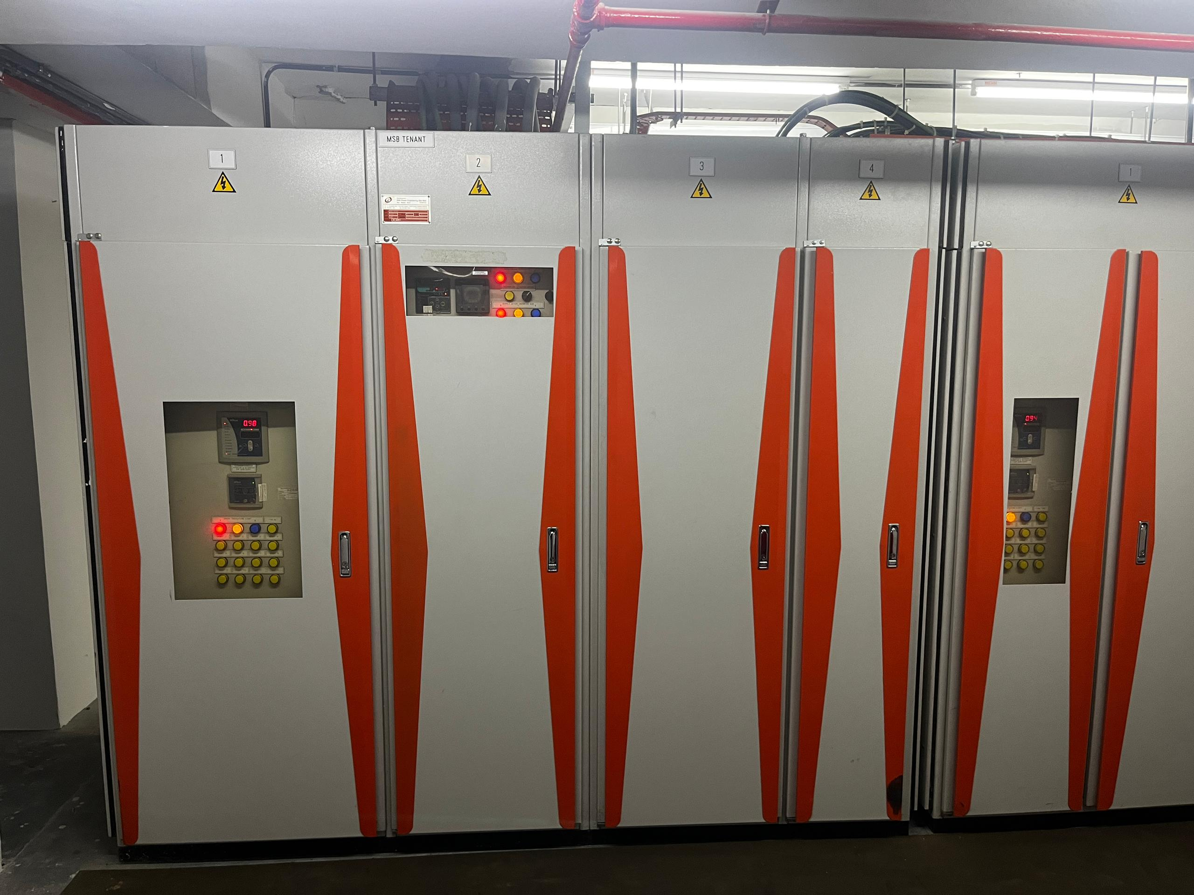
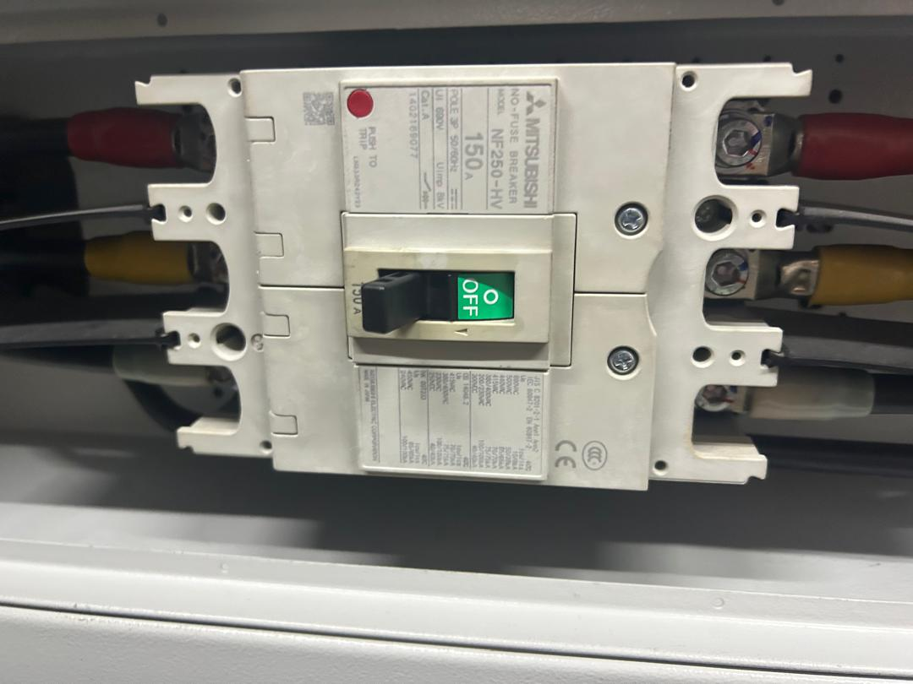
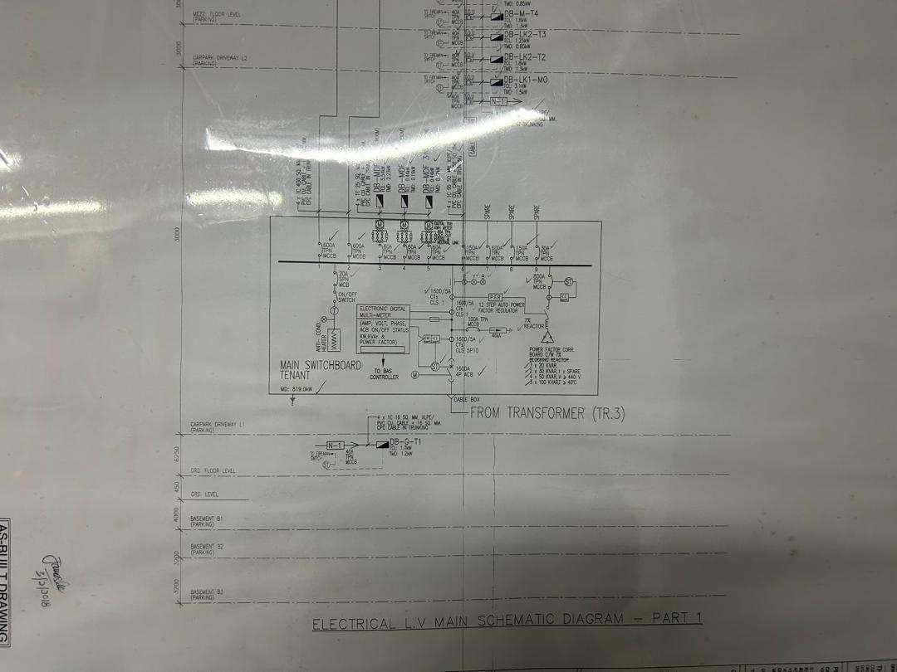
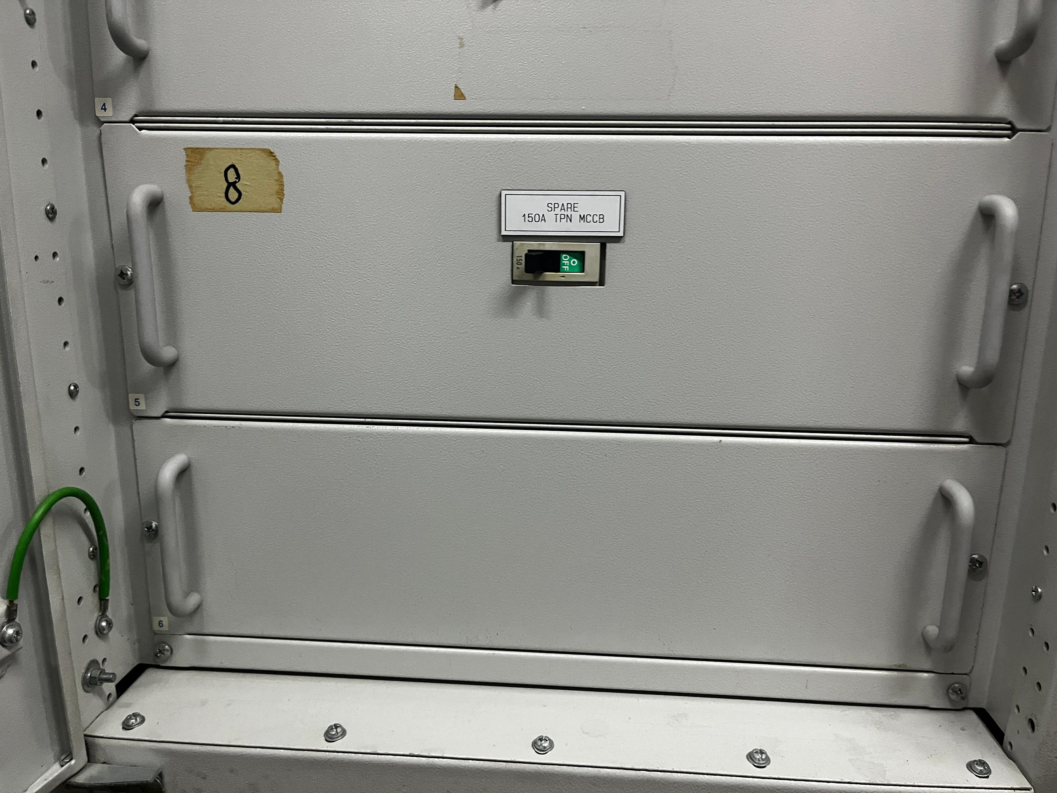
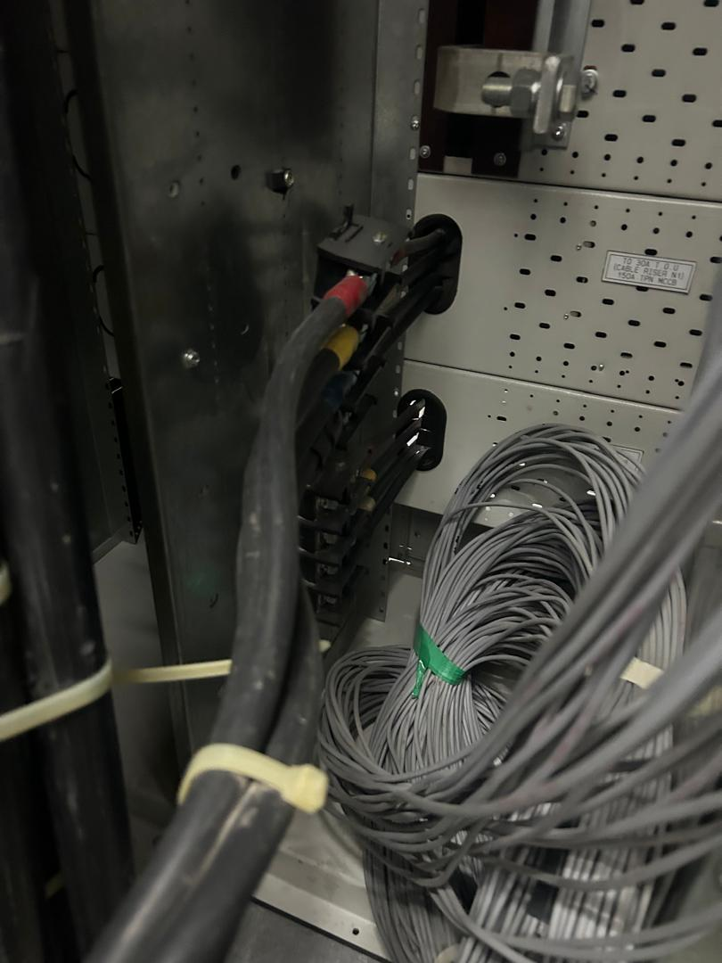
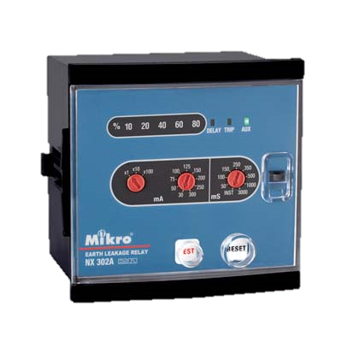
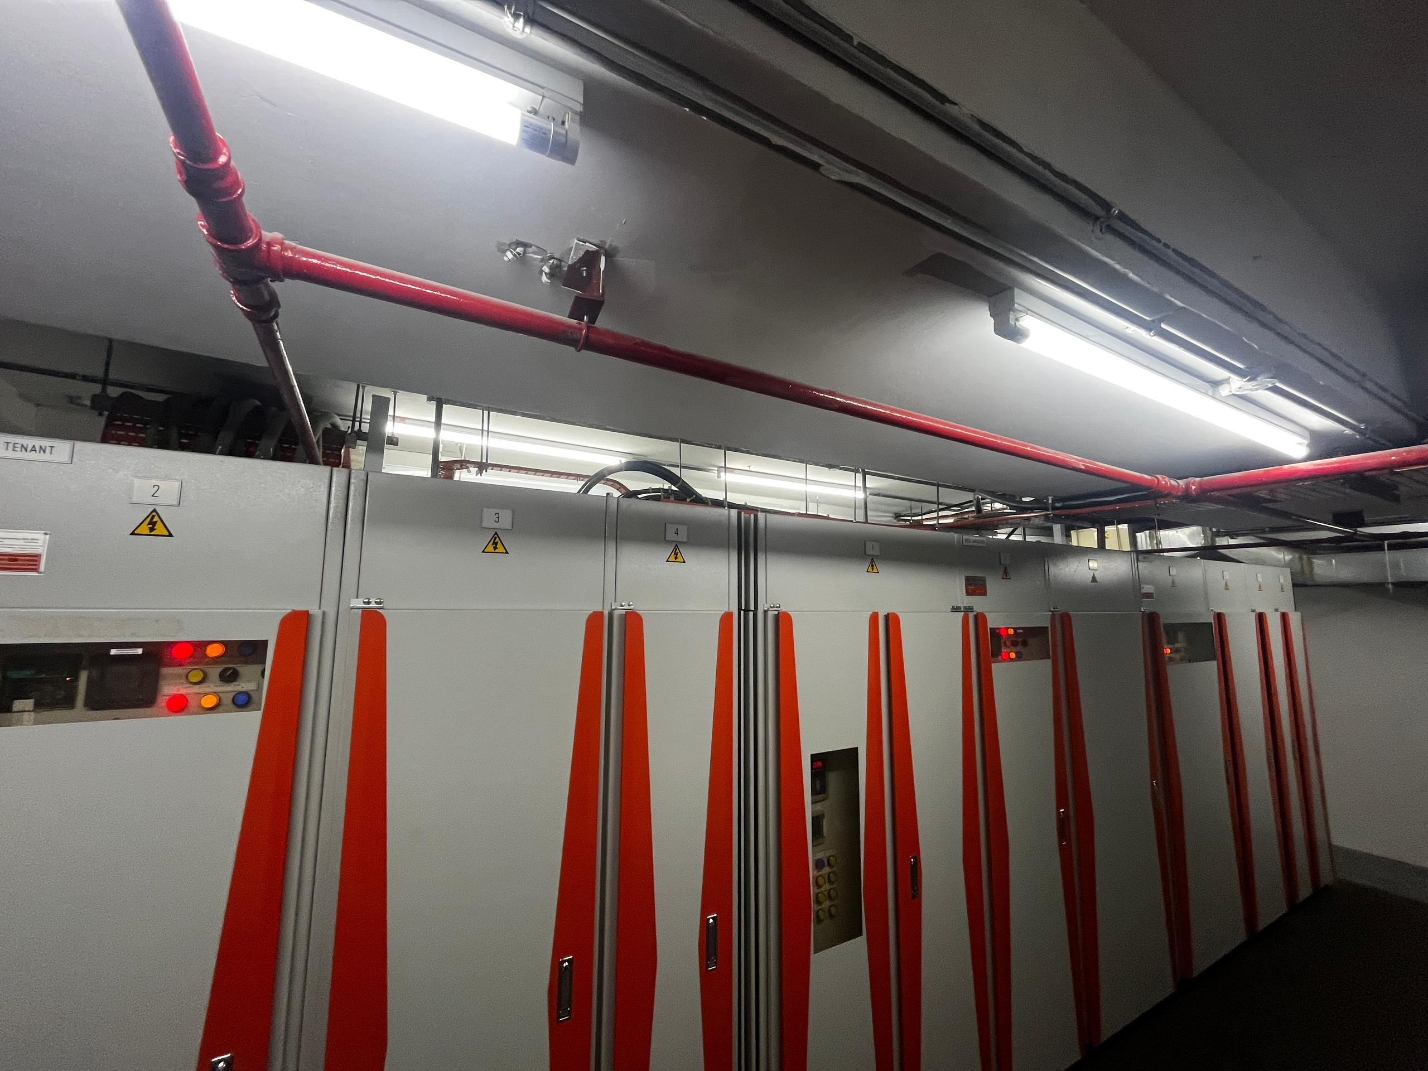
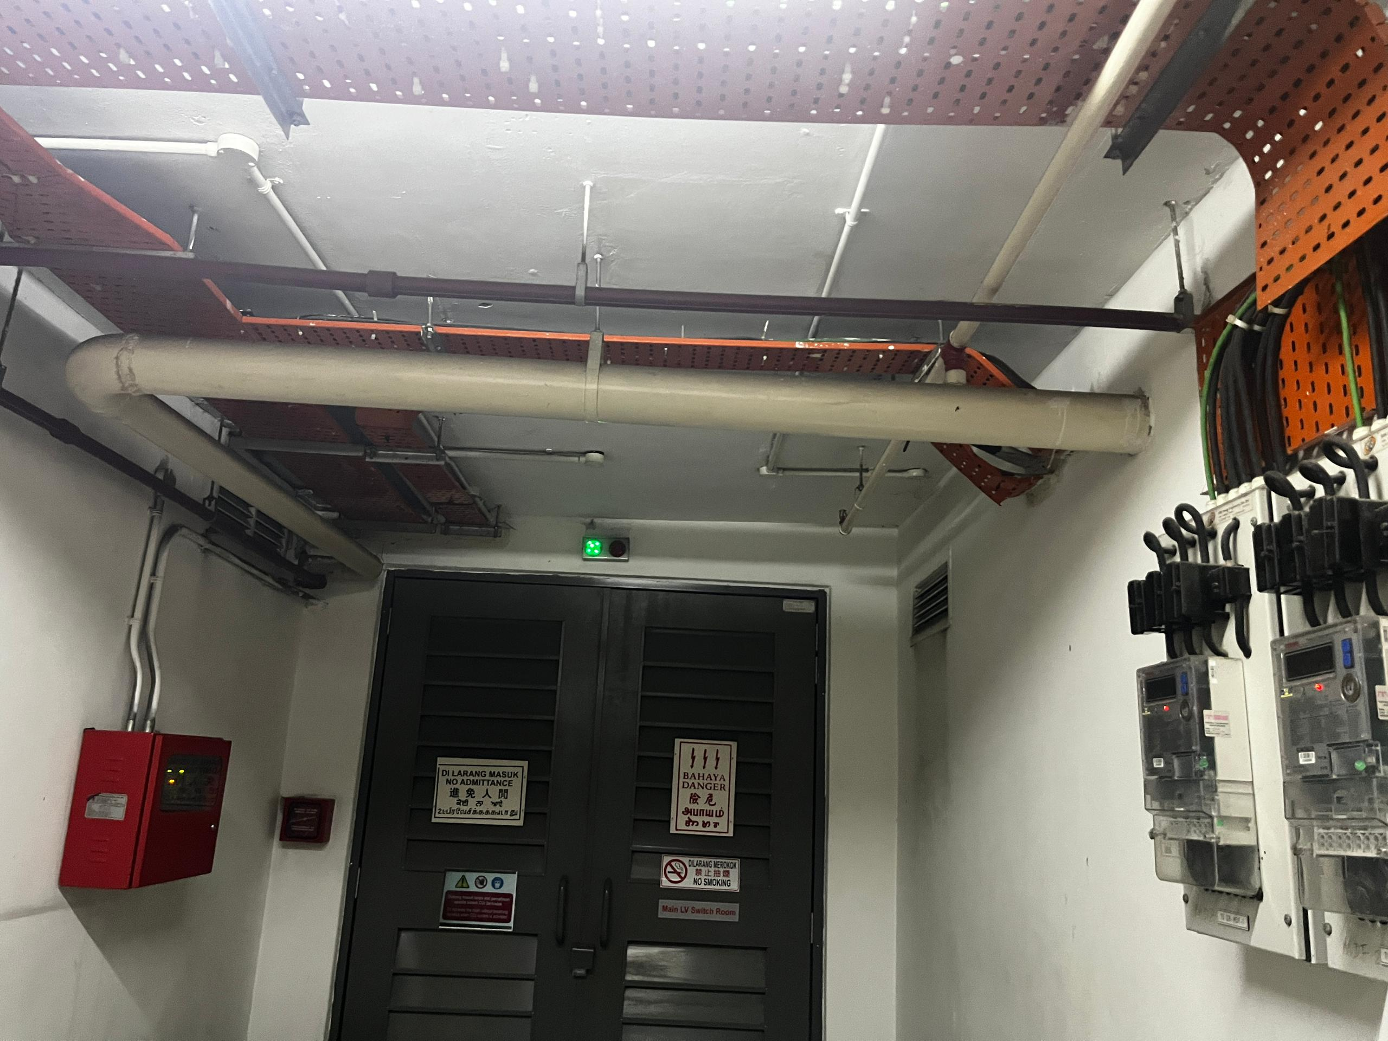
12. TECHNICAL PROPOSAL
12.2 Main Incoming Power Supply
Picture 1: Proposed to Upgrade 1 x MCCB 150A TPN (Spare) to 1 x MCCB 100A TPN (New)
Proposed incoming power supply from MSB
Picture 2 : Proposed power supply cable with PE from MSB to EVDB via existing cable tray.
Proposed power cable routing to EVDB

Slide 2
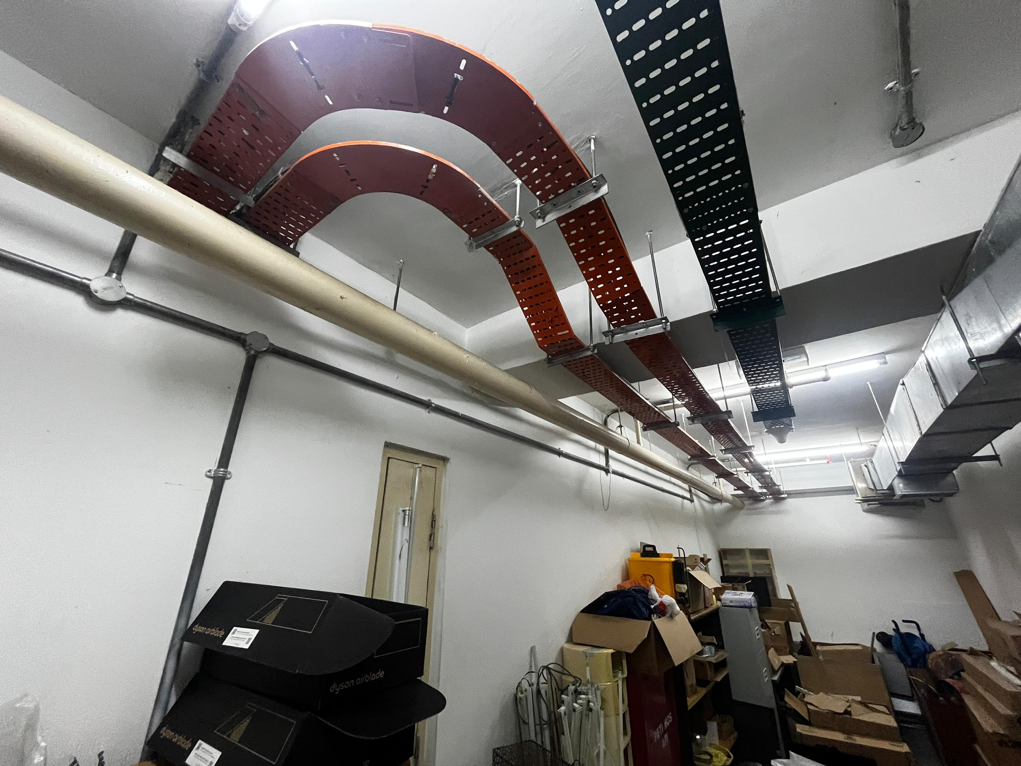
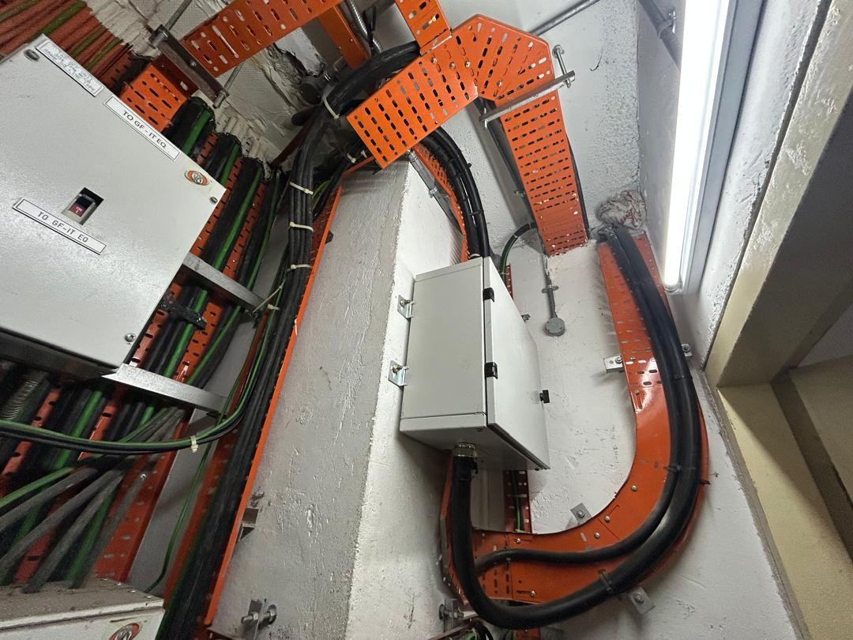
12. TECHNICAL PROPOSAL
12.3 Power Supply Cable Routing
Picture 3 : Proposed power supply cable with PE from MSB to EVDB via existing cable tray.
Proposed power cable routing to EVDB
Picture 4 : Proposed power supply cable with PE from MSB from EVDB via existing cable tray.
Proposed power supply cable routing to charging stations

Slide 3
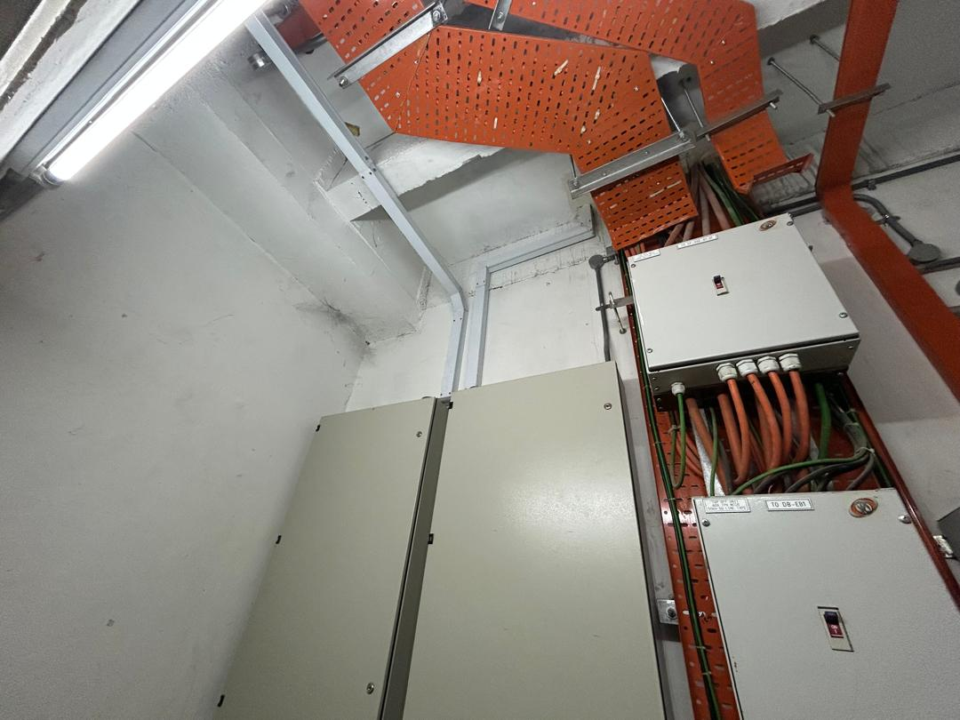
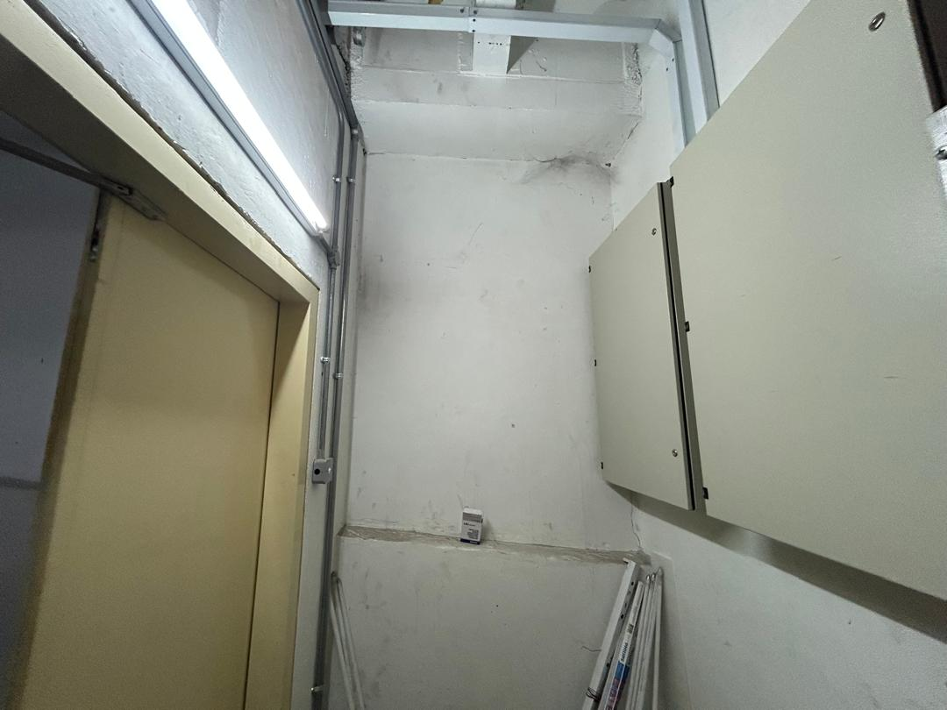
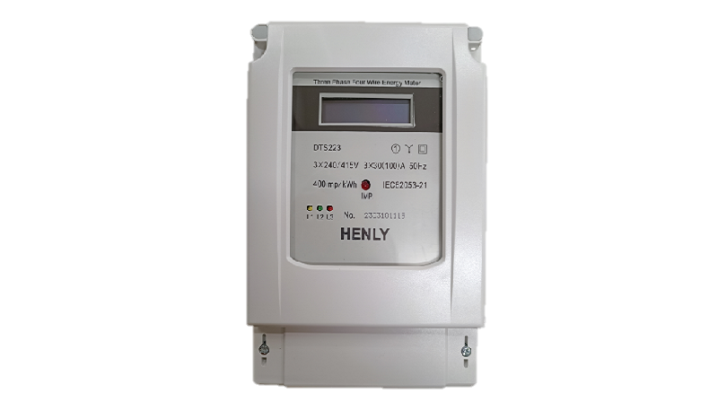
12. TECHNICAL PROPOSAL
12.3 Power Supply Cable Routing
Picture 5 : Proposed power supply cable with PE from MSB to EVDB via existing and proposed cable tray
Proposed power supply cable routing to charging stations
Picture 6 : Proposed power supply cable with PE from MSB to EVDB via existing and proposed cable tray
Proposed to install 2 x 22kW EV AC charging stations

Slide 4
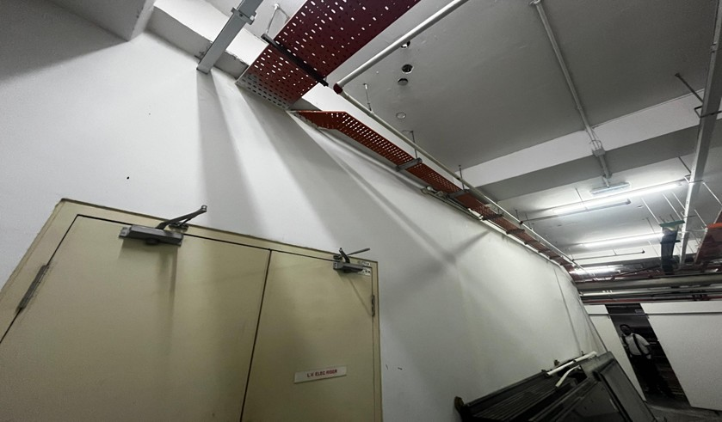
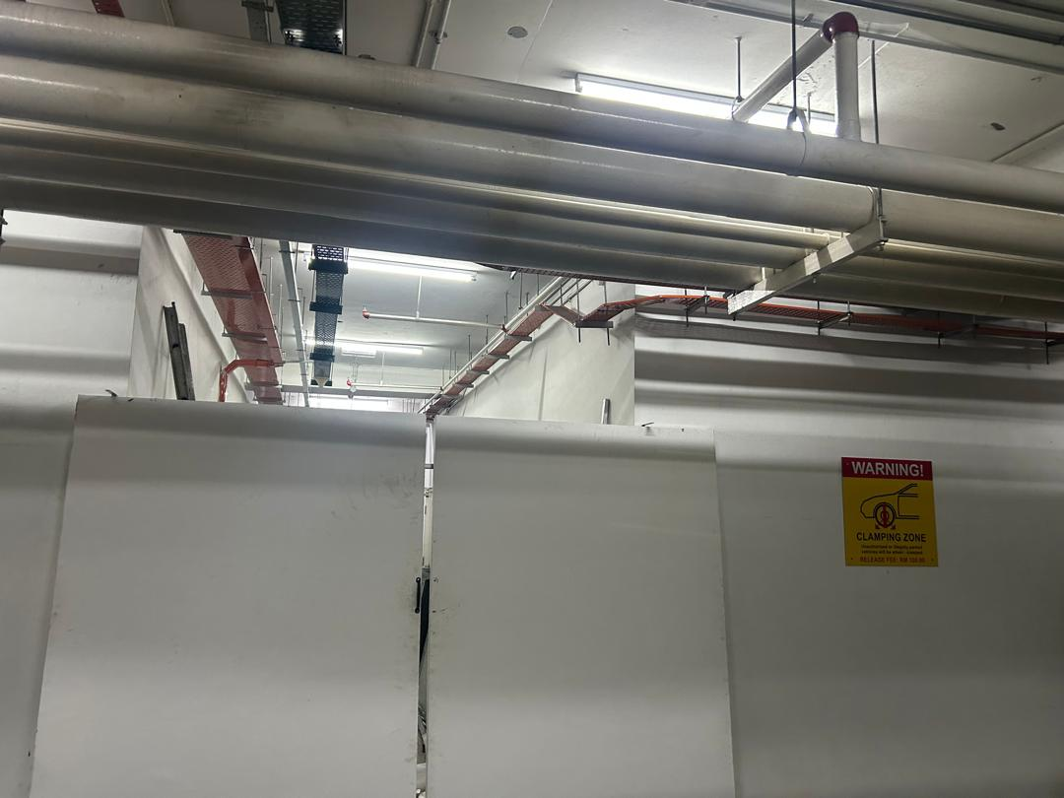
12. TECHNICAL PROPOSAL
12.3 Power Supply Cable Routing
Picture 7 : Proposed power supply cable with PE from MSB to EVDB via existing cable tray
Proposed power supply cable routing to charging stations
Picture 8 : Proposed power supply cable with PE from MSB to EVDB via existing cable tray
Proposed to install 2 x 22kW EV AC charging stations

Slide 5
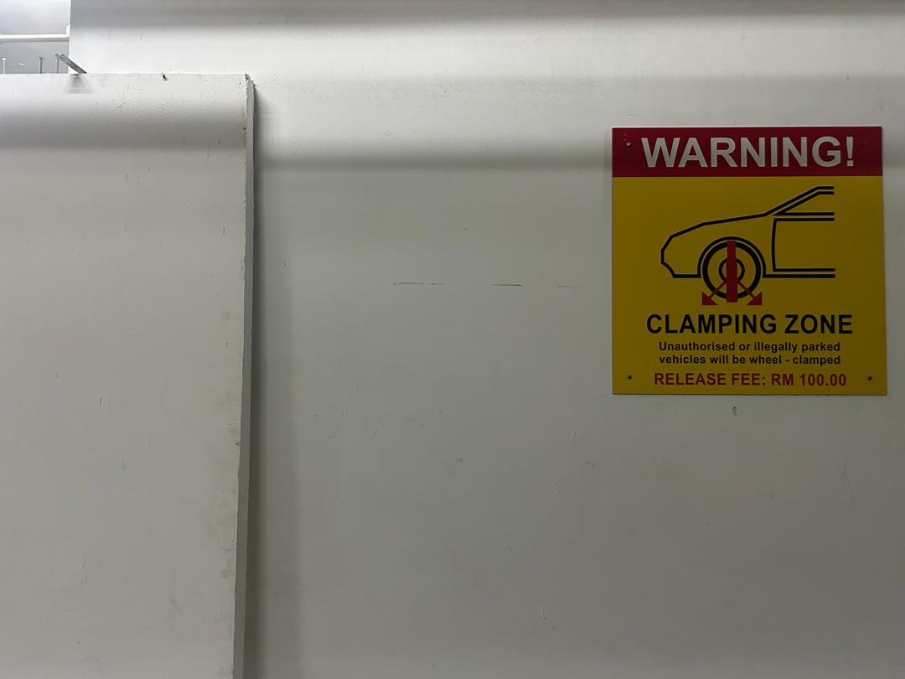
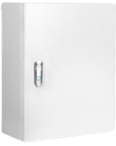
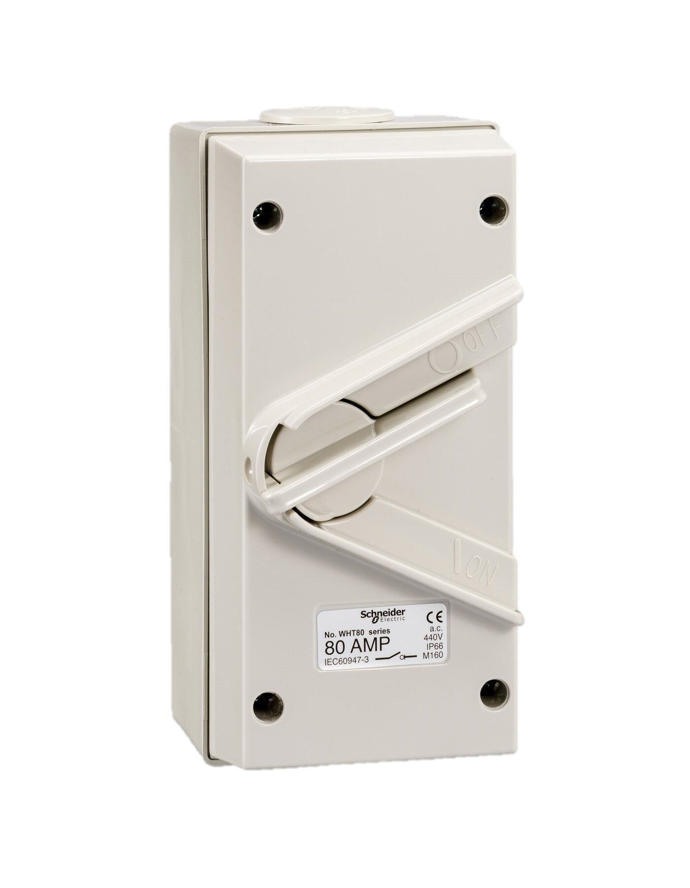
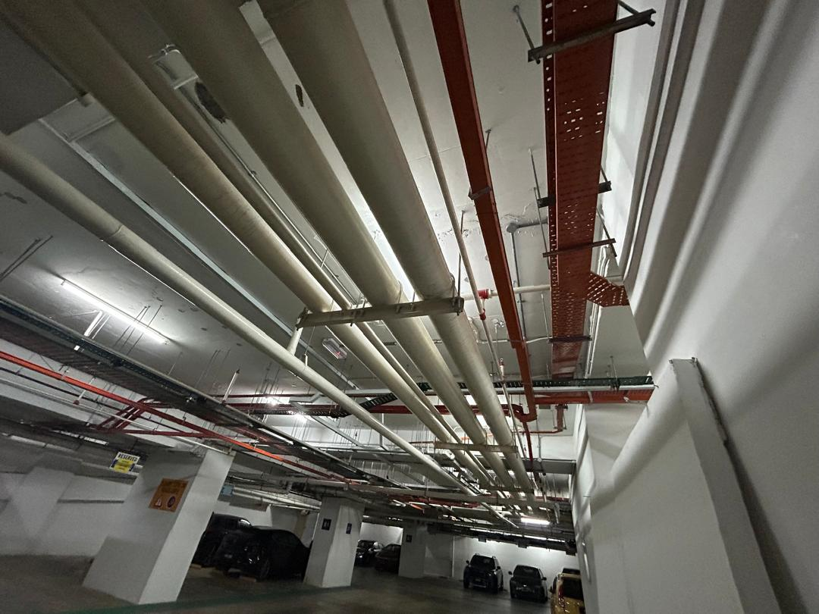
12. TECHNICAL PROPOSAL
12.3 Power Supply Cable Routing
Picture 9 : Proposed power supply cable with PE from MSB to EVDB via existing cable tray
Proposed power supply cable routing to charging stations
Picture 19 : Proposed power supply cable with PE from EVDB to charging stations via proposed cable trunking.
Proposed to install 2 x 22kW EV AC charging stations

Slide 6
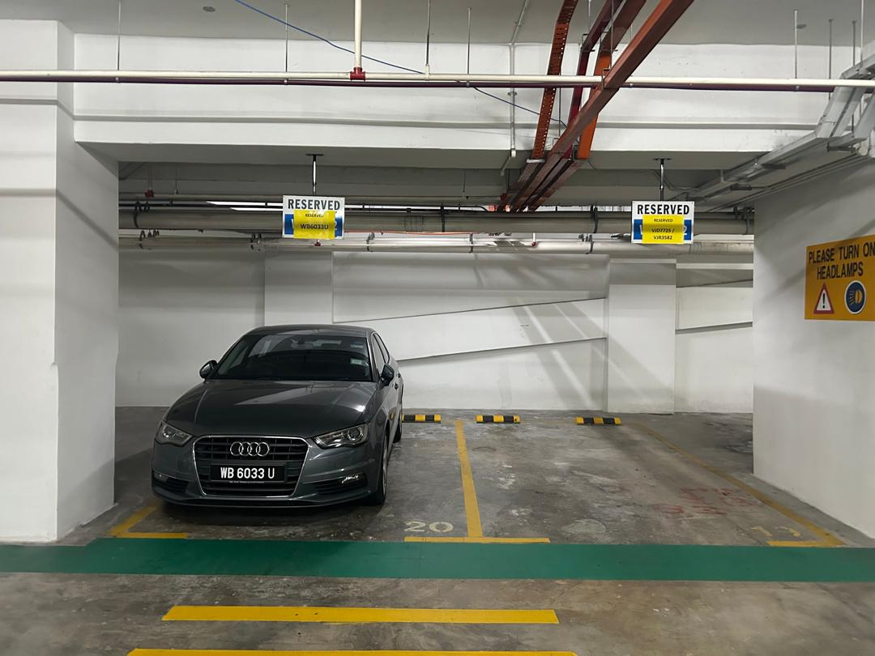
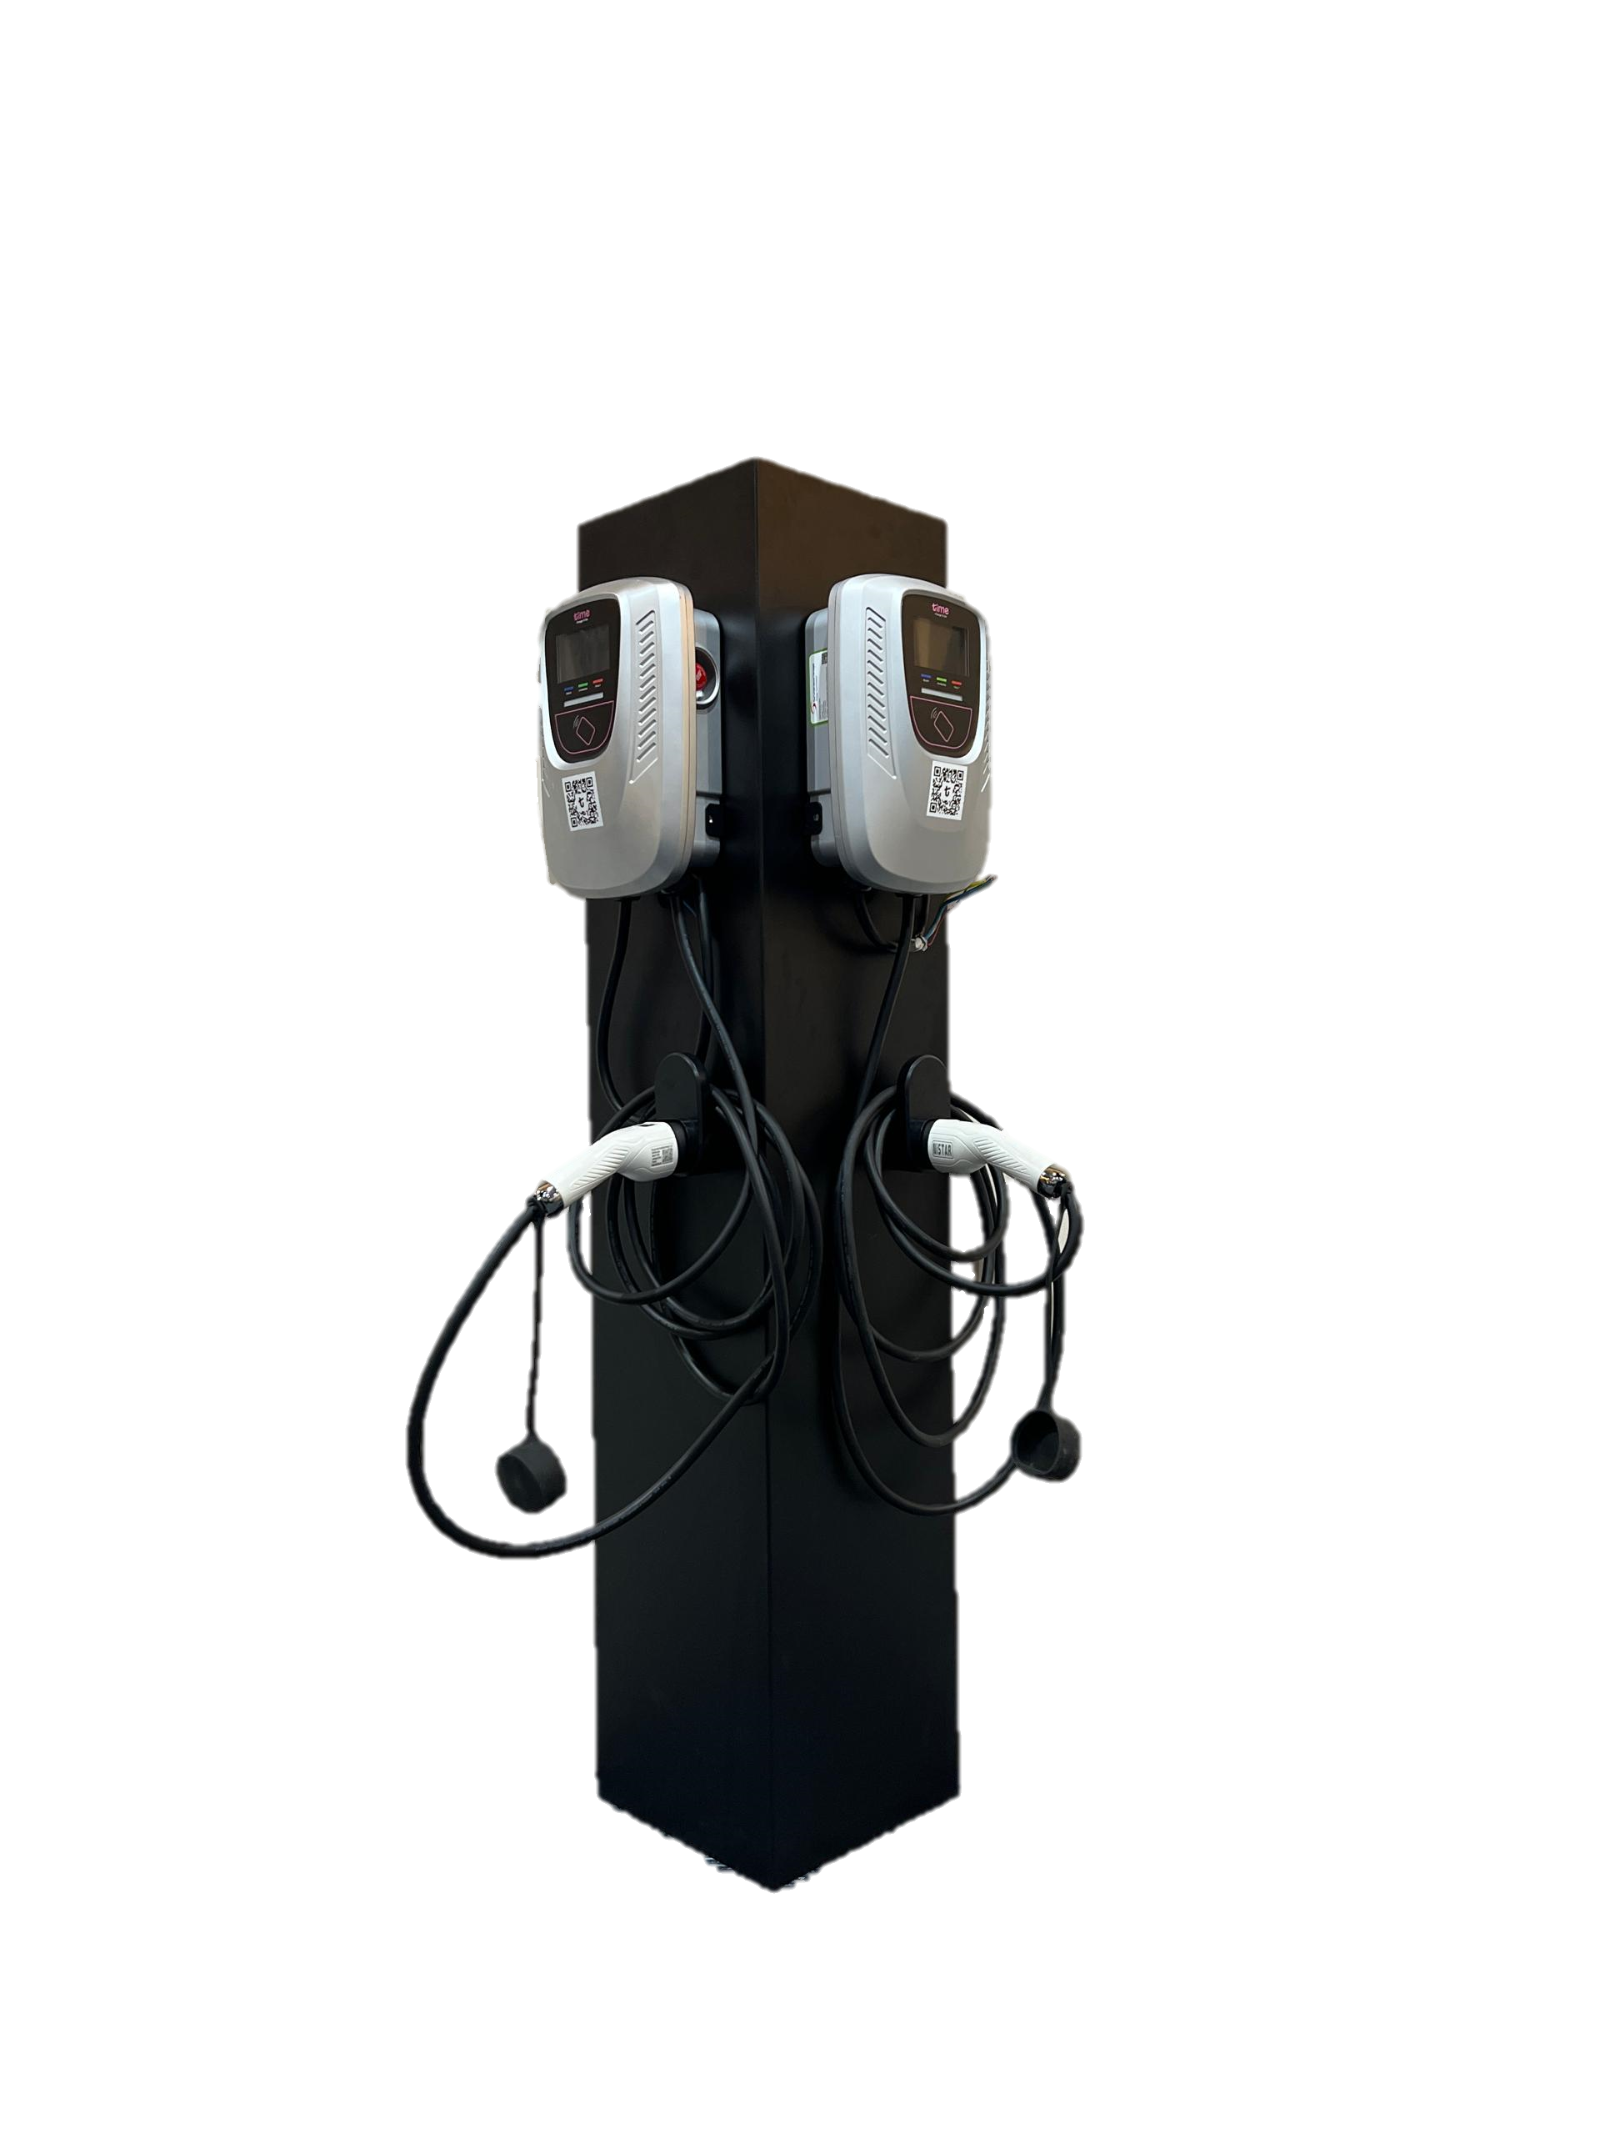

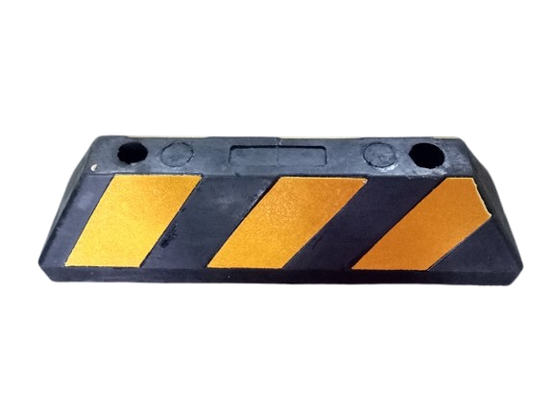
12. TECHNICAL PROPOSAL
12.4 EV Charging Bays
Picture 11 : Proposed to install 2 x 22kW EV AC chargers on pedestal via proposed cable trunking.
Proposed to install 2 x 22kW EV AC charging stations

Slide 7
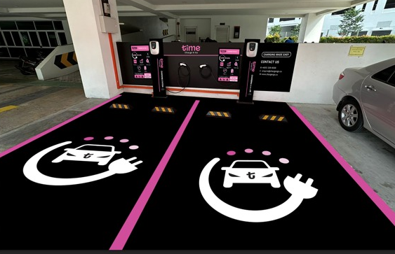



12. TECHNICAL PROPOSAL
12.5 Wall Graphic Layout
Sample signage and parking bay graphic view

Slide 8
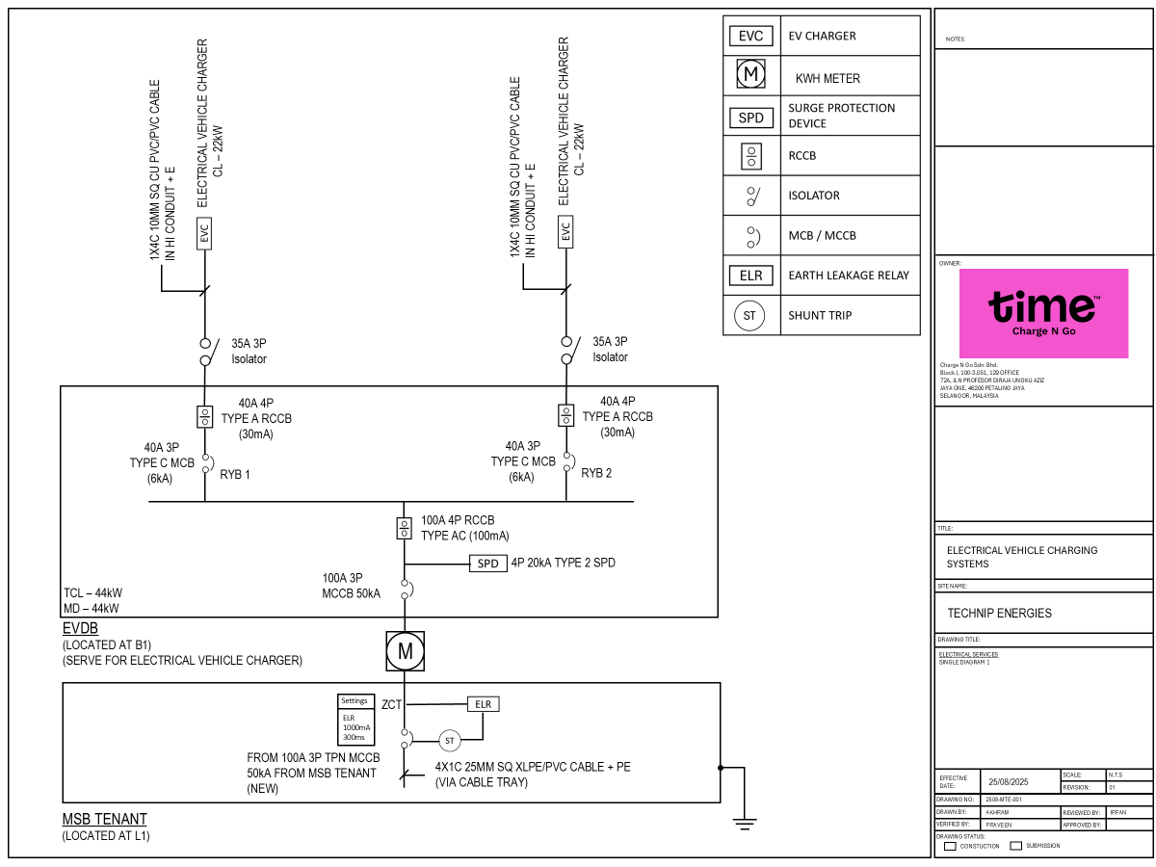

Slide 9
12. TECHNICAL PROPOSAL
12.6 TP Acknowledgement
 | Building Management/ PIC | CNG Implementation Manager | CNG Head of Engineering
Chop & Sign:
Name: Date:

